Slide 1



KS1 Relationships:
Our Special People
Home Learning: Looking after each other
Play this slideshow from beginning
© PSHE Association 2020

Slide 2


    We are learning about the special people in our lives and how we care for each other
  We will be able to:
identify people who are special to us (our own special people)
explain what makes them special and why they are important to us
describe how our special people care for us
recognise how we can show we care for people special to us
© PSHE Association 2020

Slide 3
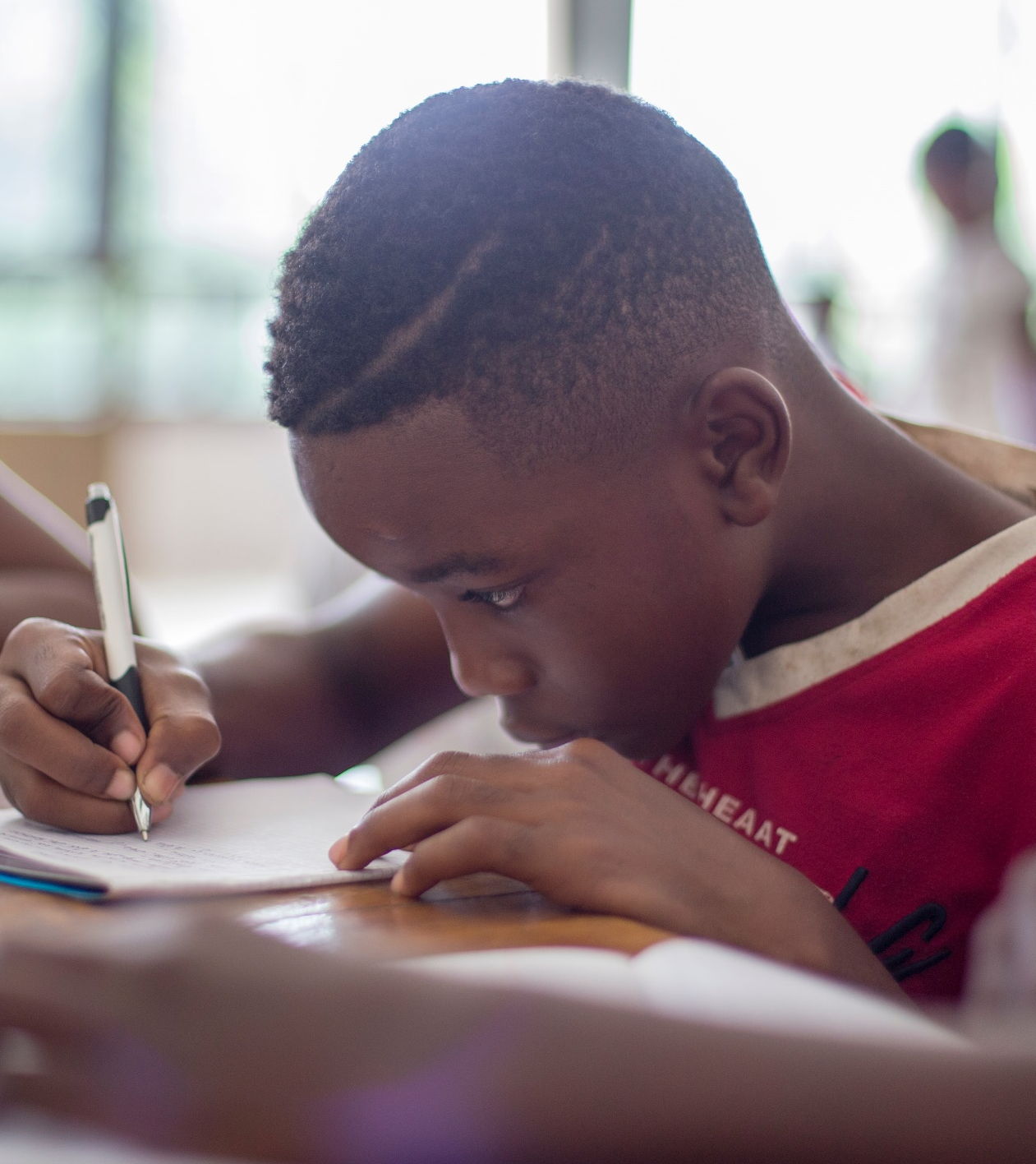

What’s our starting point?
Draw and write
Think about your friends and family.
Draw or write about the different ways friends and family show they care for each other.

Slide 4
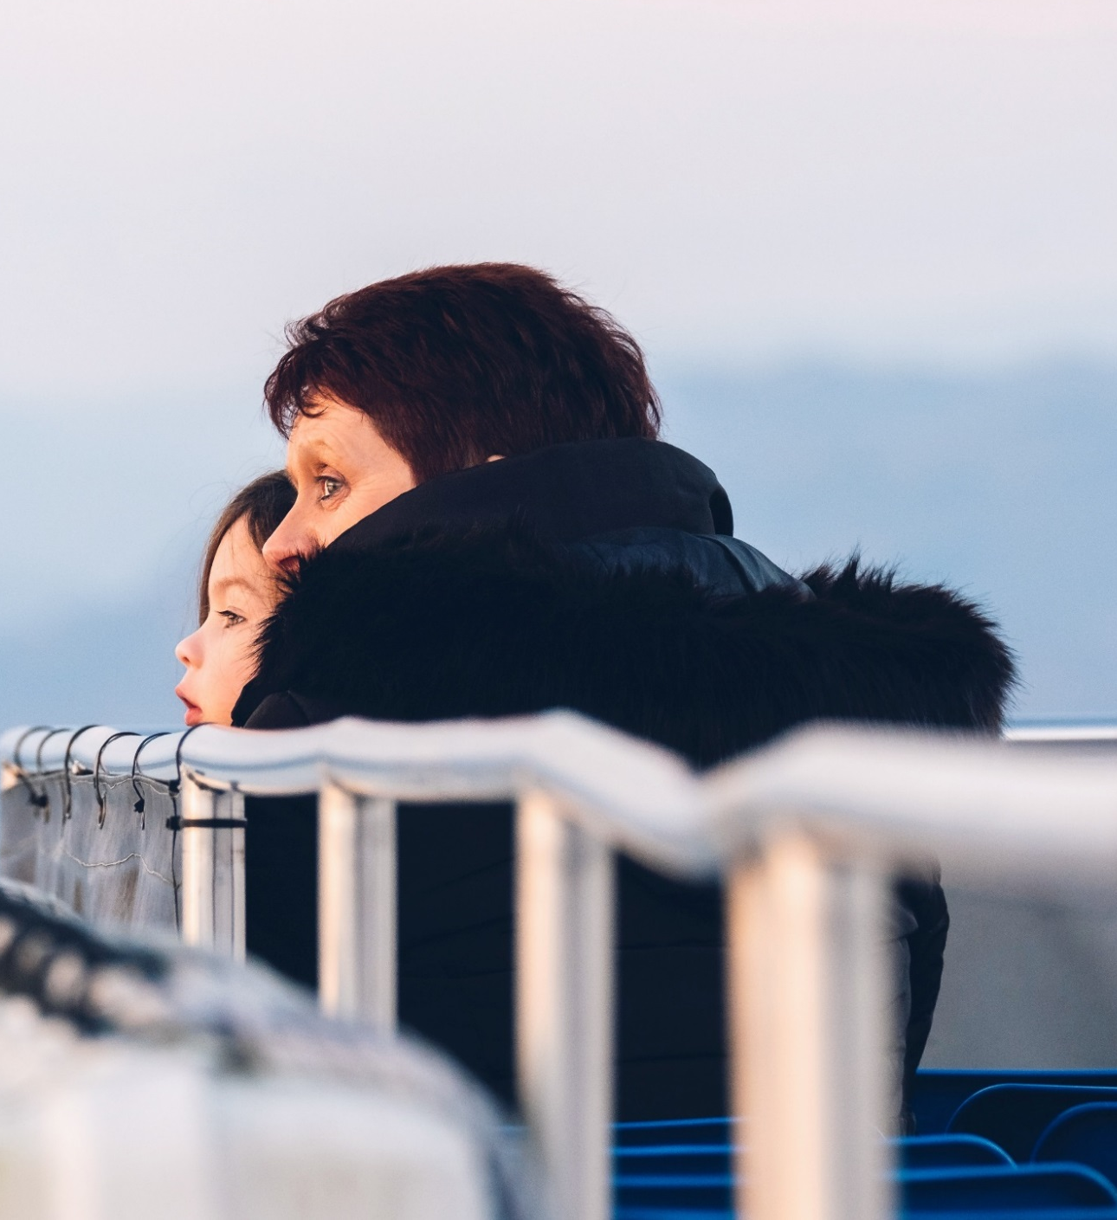
Suri and Gran
Suri is thinking about her special people. She is writing about Gran.
Suri thinks Gran is a really special person. Gran always wears big earrings and she loves red lipstick. Gran says it makes her feel bright and happy.
When Suri is at school, Gran picks her up. Last summer they went to the park all the time. Suri loved the roundabout when Gran swung her round so fast! Suri also liked it when Gran used to come over to babysit, because Gran always told the funniest bedtime stories.
© PSHE Association 2020

Slide 5
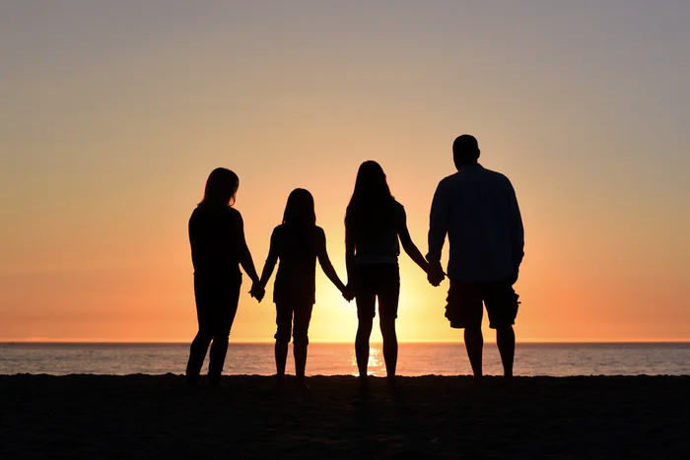
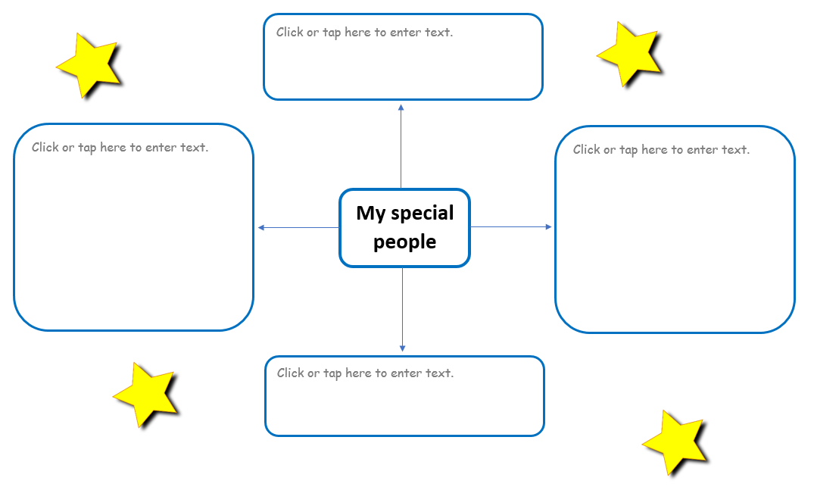
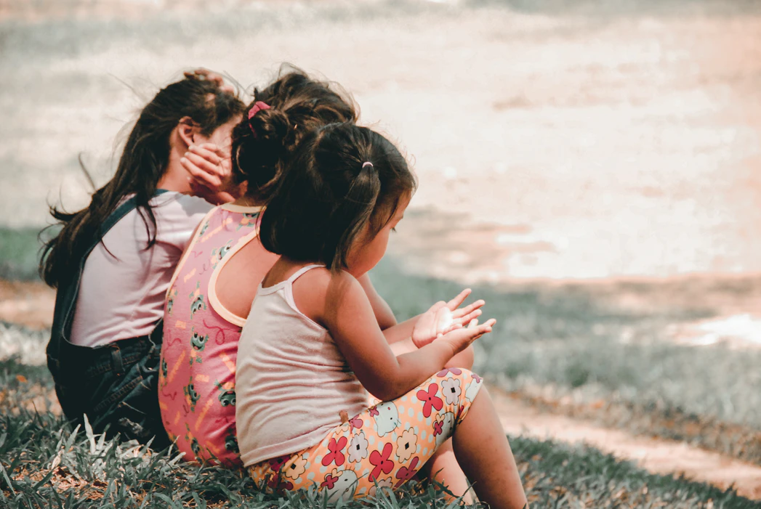
Your special people
Think about people who are special to you. It might include your friends or people in your family.
Use Resource 1 (or a piece of paper) and make a spider-gram of your special people.
© PSHE Association 2020

Slide 6

A special person
Read Suri’s example (slide 4) and then use these questions to help you with your writing:
Write about a person who is special to you.
What words describe your special person?
What do they do that is special?
What things do you and your special person like doing together?
Why are they an important person to you?
© PSHE Association 2020

Slide 7
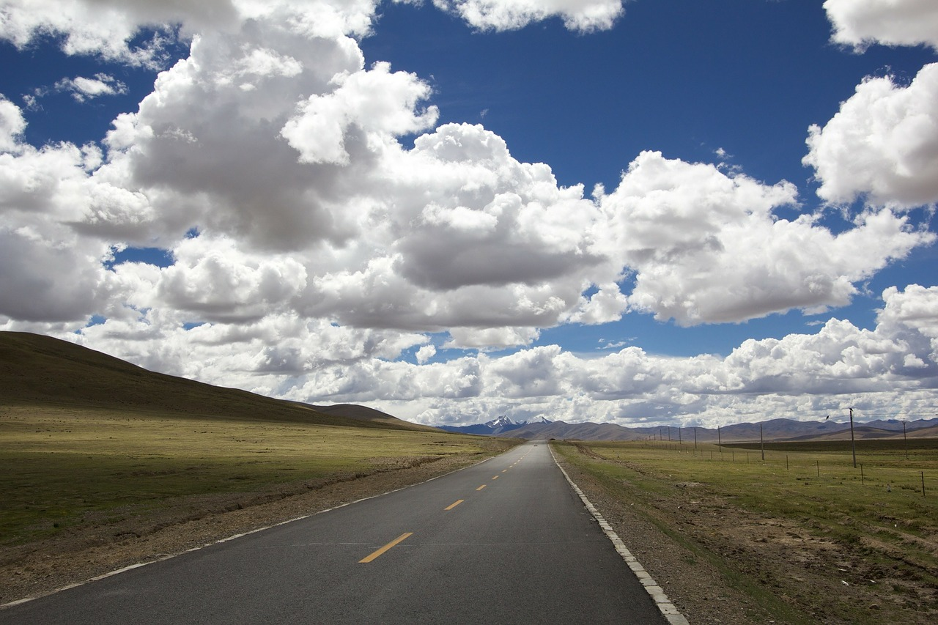
Special people
Near and far…
We may not be with our special people all the time. Maybe they live far away from us, or can’t come and visit often. There might be lots of reasons why we can’t see our special people when we want to.
But it’s still important to let them know we care.
© PSHE Association 2020

Slide 8
How can we show we care?
Use the list in Resource 2 to sort the ideas. Add some ideas of your own. If there are things that could go in both circles, put those in the middle.
Things we can do for special people we see all the time
Things we can do for special people we only see sometimes or not very often
© PSHE Association 2020

Slide 9
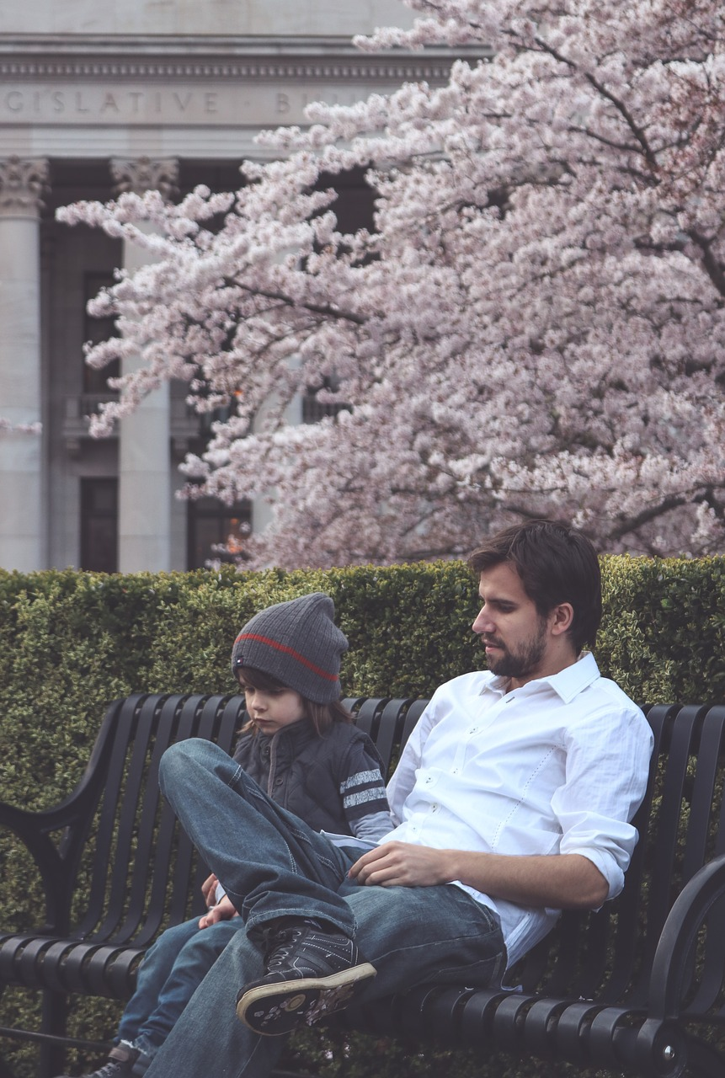
Missing our special people
When we can’t see our special people as often as we’d like, it can sometimes make us feel sad.
If you miss seeing someone special a lot and feel worried about them, remember to talk to an adult you trust — your mum, dad or the person who looks after you.
They can help you catch up with your special people.
© PSHE Association 2020

Slide 10
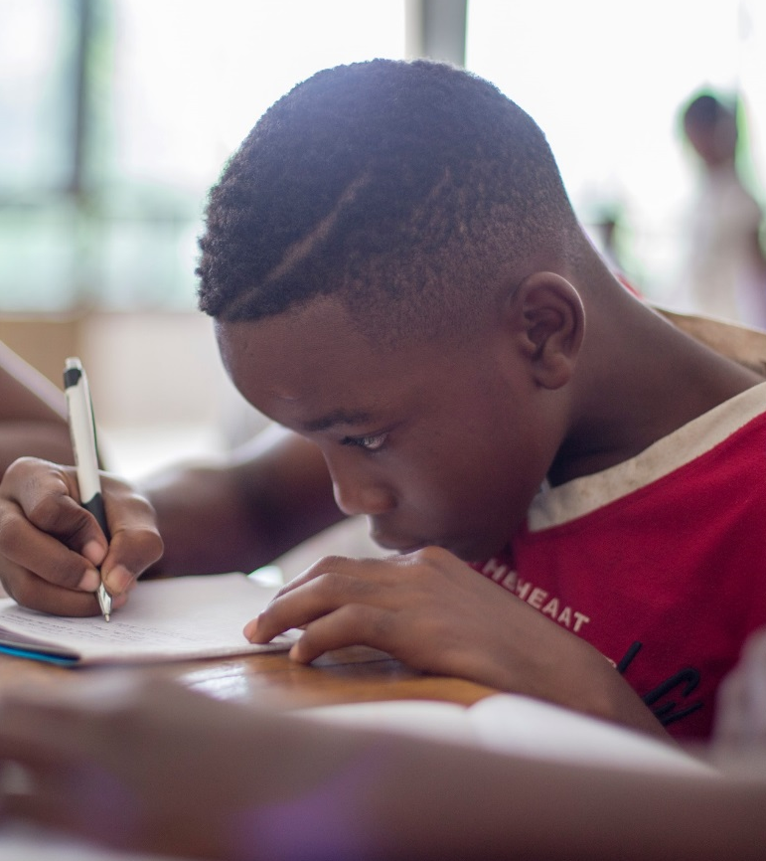


Special People – Looking after each other
Where are we now?
Well done on completing the activities!
Now go back to the ‘What’s your starting point?’ activity.
Draw or write about the different ways friends and family show they care for each other.
Is there anything you would like to change?
Is there anything you would like to add?
© PSHE Association 2020

Slide 11

Additional activity
Think about what you can say and do to let your special person know they are special.
Make a thank you card for a special person (someone you know well).
Use these questions to help you:
Why are they special to you?
What would you like to thank them for?
© PSHE Association 2020

