Slide 1
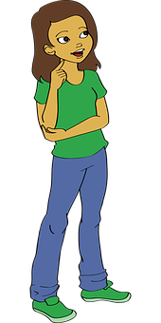

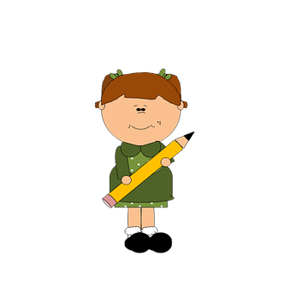


Parents: read our helpful guidance before you start
KS2 Home learning:
Influences and decisions
Play this slideshow from beginning
Remember! You can use your own paper to do the activities on, or type on the worksheets. You don’t have to print them off.

Slide 2



We are learning about what influences our opinions and decision-making
We will be able to:
Identify who or what may influence our opinions or decisions.
Recognise situations where people may be positively or negatively influenced.
Identify steps we can take to manage negative influences on our opinions or decisions.

Slide 3

Influences on opinions and decisions
We all have opinions about things and these can affect the decisions we make.
Some of our opinions and the decisions we make may be a result of someone or something influencing us.
Influence means when someone or something affects someone else’s opinions or decisions.
What’s our starting point?
Make a list of who or what you think might influence a person’s opinions or decisions, (e.g. parents, family members, teachers).

Slide 4
Influences on opinions and decisions
Who might influence someone | What might influence someone
Parents/carers Sisters/brothers Faith leaders (priest, imam, rabbi) Best friend, friends Teachers Grandparents Aunties/Uncles Pop stars/celebrities | School Advertising on TV or online Online content (e.g. social media) TV programmes Video games A story someone is told about something
Your list might look similar to this...

Slide 5


People and things that influence us
Who and what are the influences in your life?
Draw three circles like the ones below
In the centre, draw or write the people and things that you think most influence your opinions and decisions.
In the next ring, draw or write the people and things that you think have some influence, but not as much as the those you put in the centre.
In the outer ring, draw or write the people and things that have some influence, but not very much.

Slide 6

Positive influences on opinions and decisions
Influences can be positive and can help us:
make good decisions/choices
recognise what is right and what is wrong
to feel confident about ourselves and the things we do
Can you think of any other ways in which people or things might influence us?
Share your ideas with a family member.

Slide 7
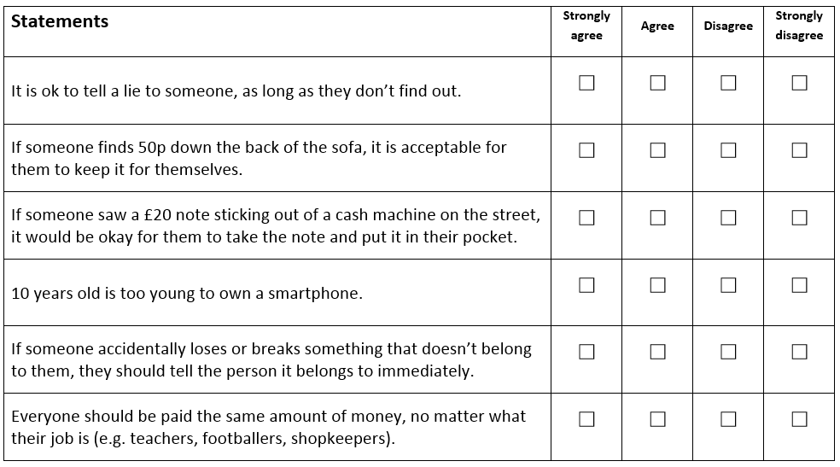
Giving opinions and recognising consequences
Read these situations (on Resource 1 in your worksheet pack).
Put a tick in the columns to show the extent to which you agree or disagree (you can type on the sheet or print it off).
Underneath each one, or on a separate piece of paper, write the reasons for your opinion, including any consequences or ways in which people might be affected by each statement or action.

Slide 8

Giving opinions and recognising consequences
Sometimes, it is clear when something is right or wrong and lots of people will agree, but other times it can be difficult to know what to do and people might have very different opinions.
Thinking about the possible consequences, and how our actions affect others, can be one way to help us decide what to do.

Slide 9
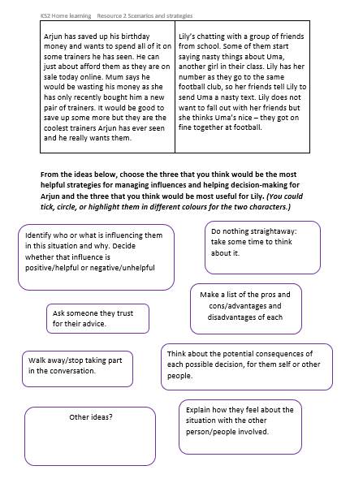
Managing influences and making decisions
Read the stories about Arjun and Lily in Resource 2 in your worksheet pack. Below the stories are some ways of managing influences to help decision-making.
Choose the three strategies that you think would be the most helpful for Arjun and the three that you think would be most helpful for Lily. There is a space for you to add your own ideas.
Did you choose different ideas for each person?
Are there any strategies that would always help, in all of the situations?
You could tick, circle, or highlight them in different colours for the two characters.

Slide 10

Remember!
In different situations, some influences are stronger than others.
Influences can be positive or helpful in some cases and negative or unhelpful in others.
We can use different strategies in different situations, to manage influences that might affect our decisions.
But it is always a good idea to consider:
who or what may be influencing our decisions,
whether the influence is helpful or unhelpful
why they might be trying to influence us (e.g. because they really want to help us, or to encourage us to spend money on something)

Slide 11

What have you learned?
Now go back to the list you made at the beginning of who or what you think might influence a person’s opinions and decisions.
Add in any new ideas you have about:
what influences people’s opinions and decisions
how situations may be influenced both positively and negatively
different ways in which influences can be managed to help with decision-making

Slide 12

More activities
Write a message to Arjun or Lily, giving them advice about how to make the best decision they can.
Write your own story about someone who has to consider and manage different influences on them and make a decision about what to do.

